Slide 1
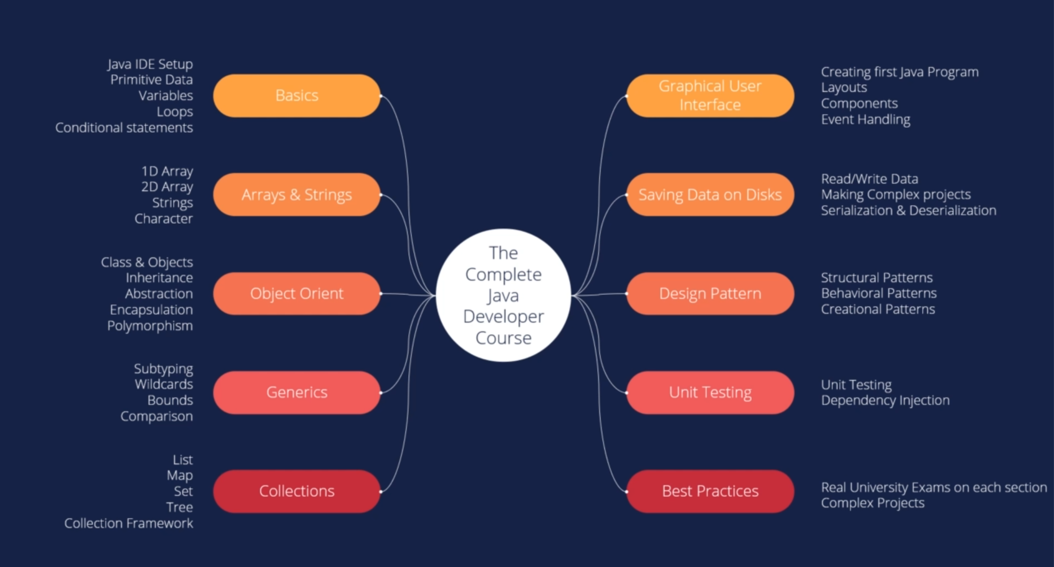

Slide 2
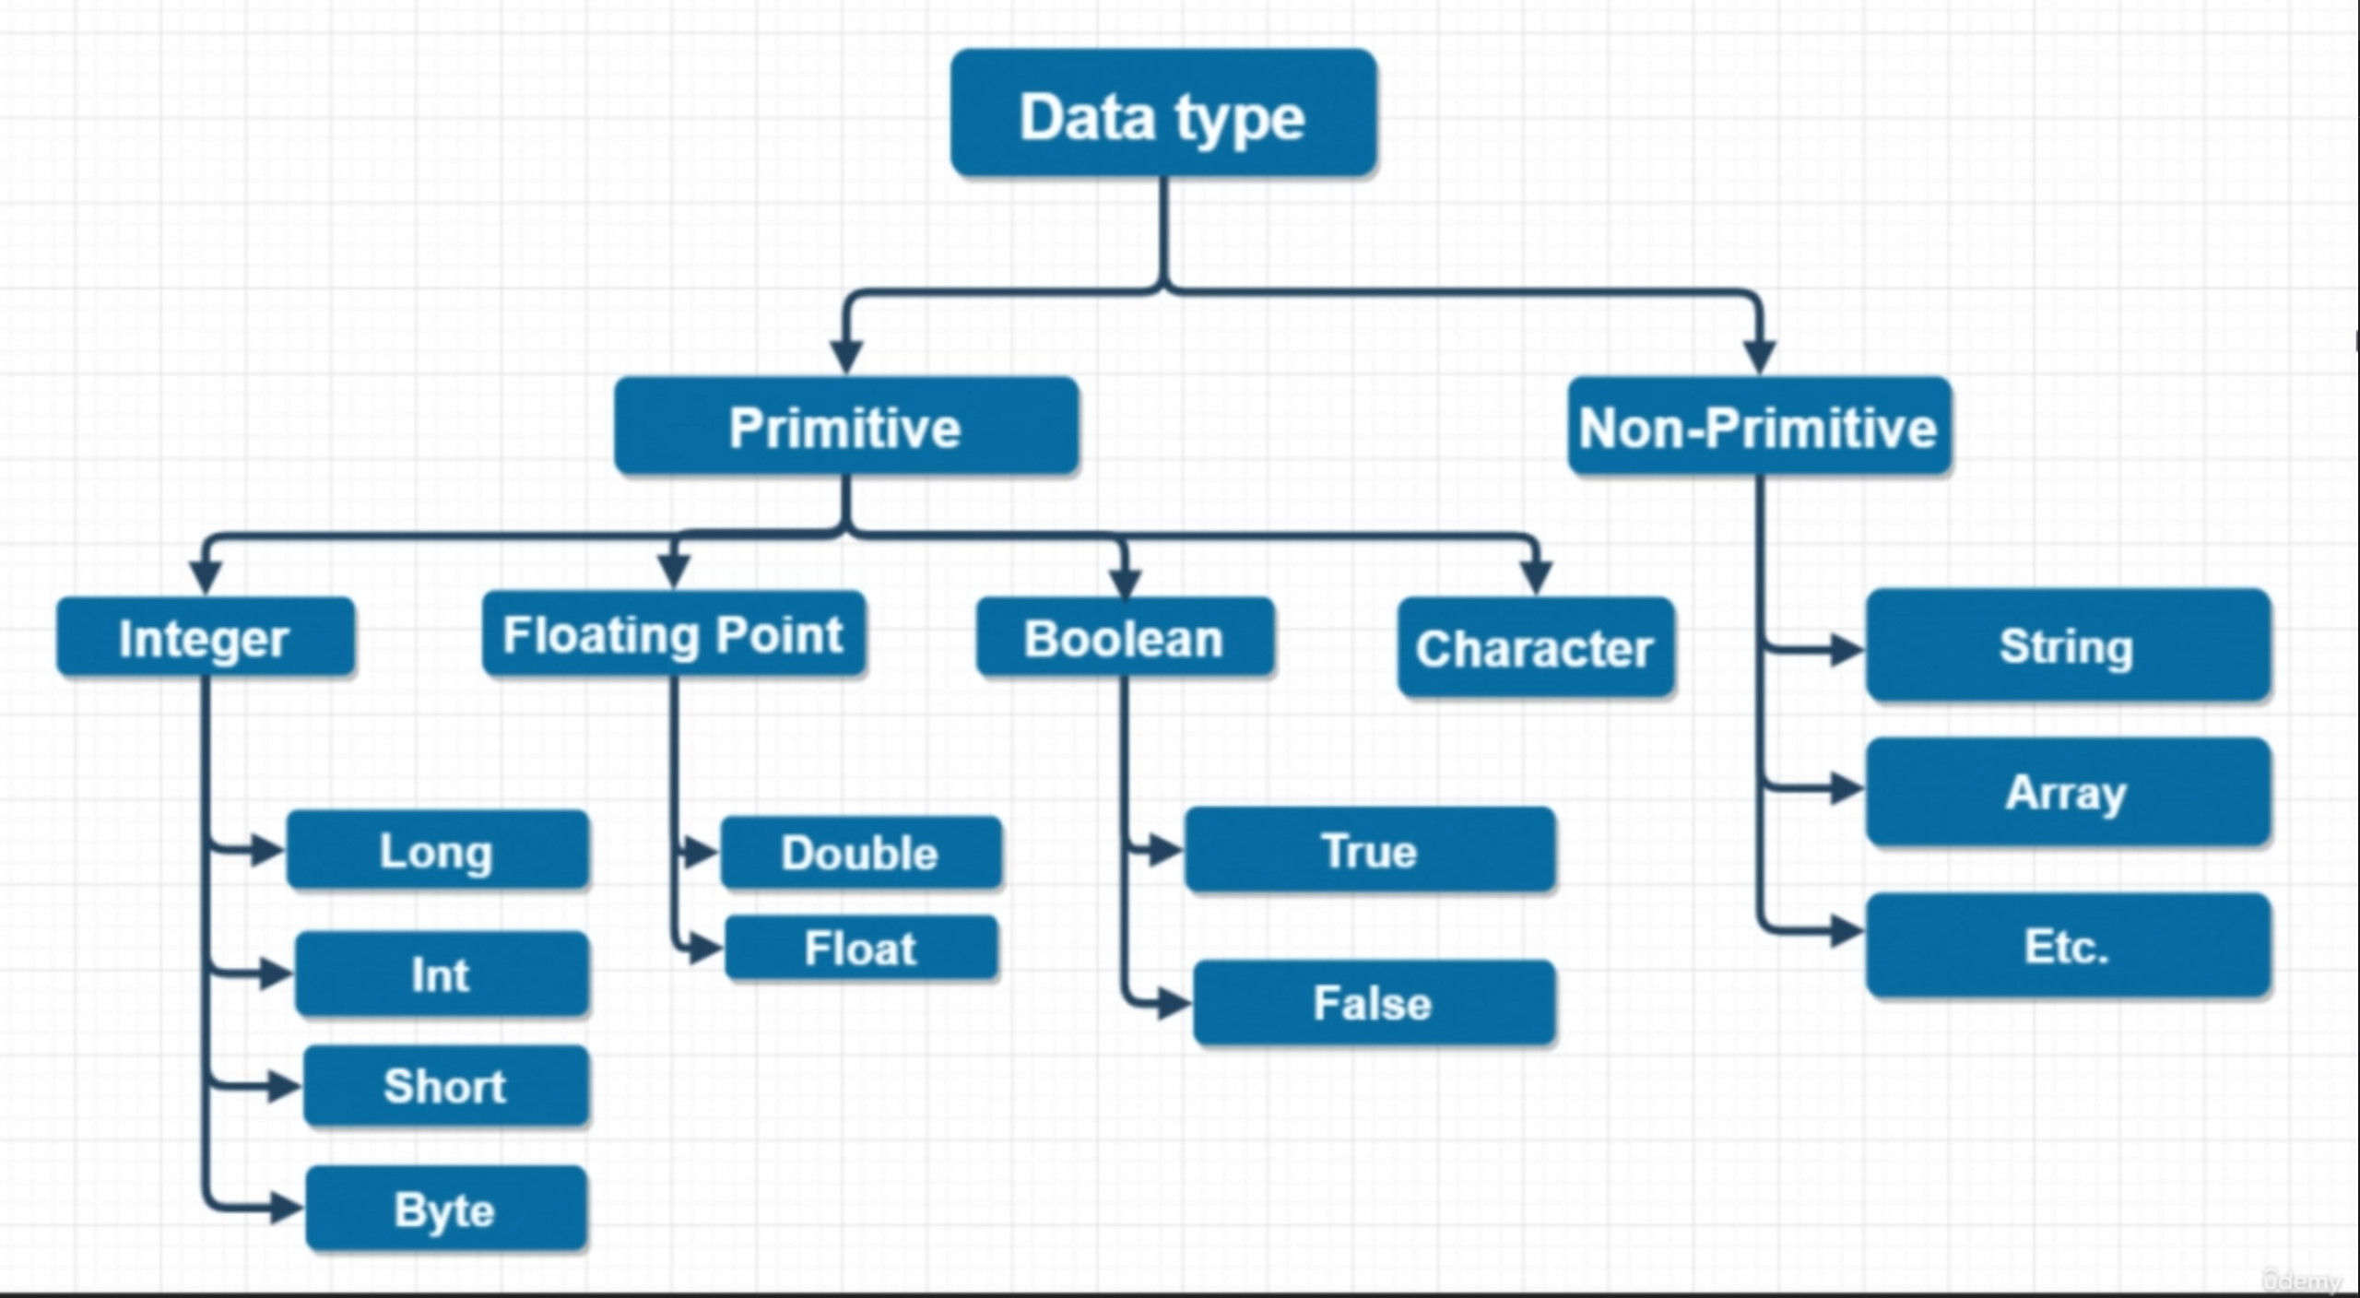

Slide 3
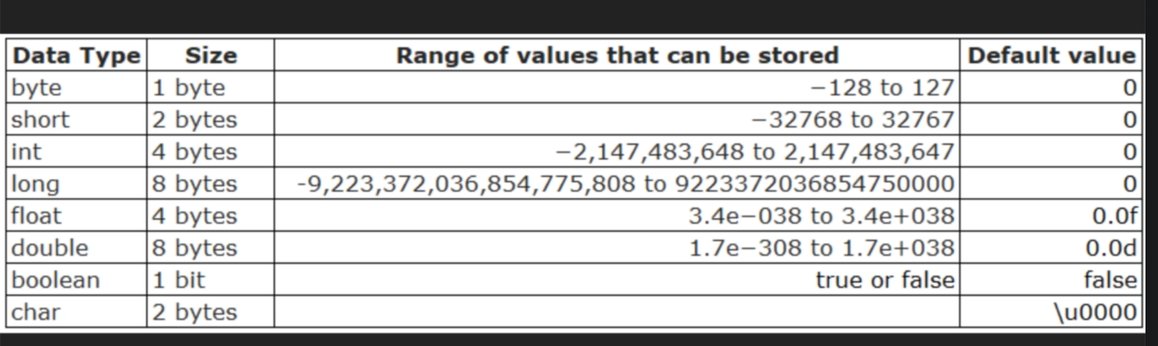

Slide 4
Java code challenge
Convert Temperature from Celsius to Fahrenheit: Write a Java program that takes a temperature value in Celsius as input and converts it to Fahrenheit.
The formula for converting Celsius to Fahrenheit is: F = (C × 9/5) + 32, where F is the temperature in Fahrenheit and C is the temperature in Celsius.

Slide 5
Java code challenge
Write a java program that allow the user to enter his weight and height, and display the body mass index for the user
The formular is BMI = kg/m2
Where kg = persons weight
m = persons height in meter.

Slide 6
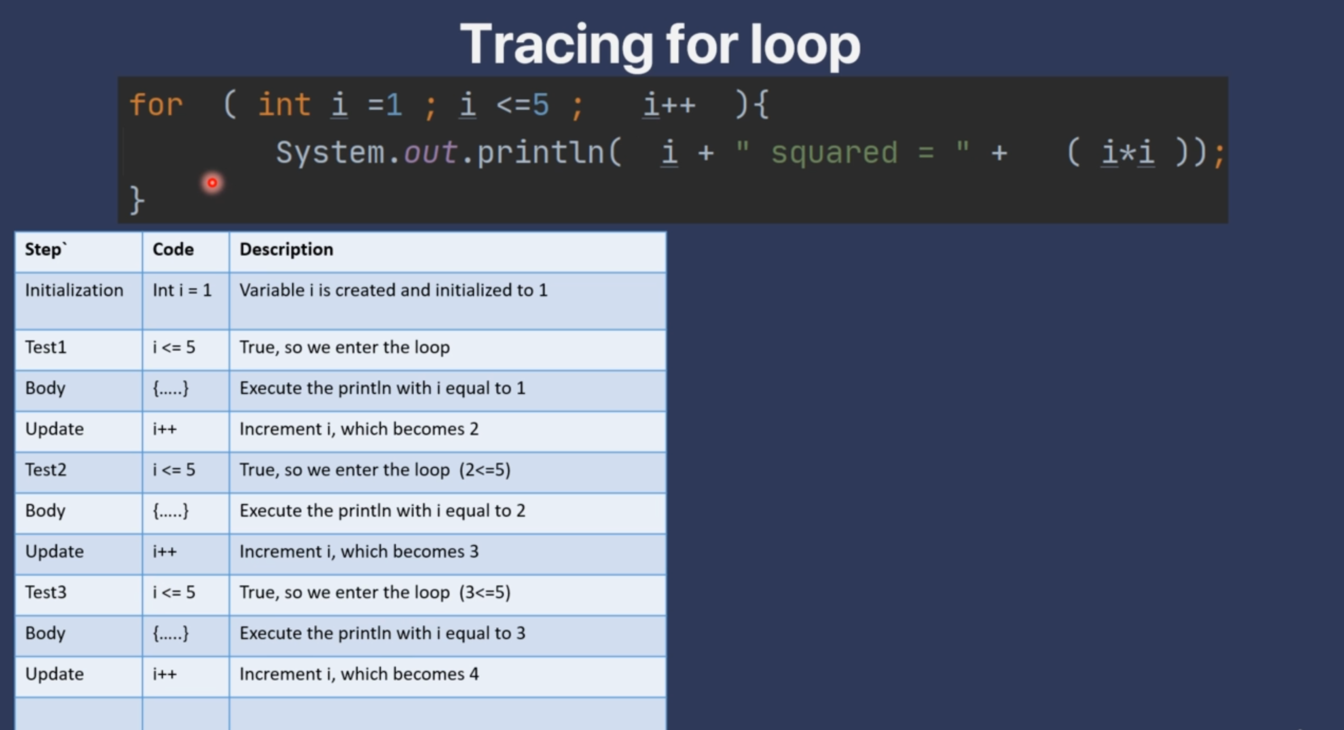

Slide 7
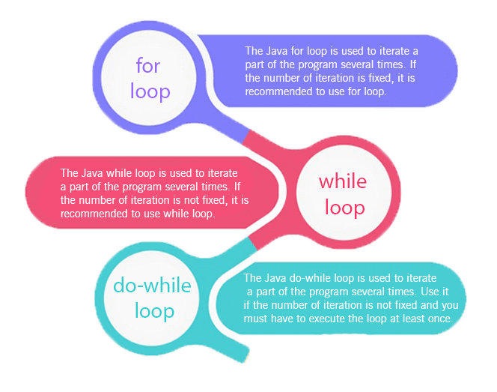
Loops in Java
The Java for loop is used to iterate a part of the program several times. If the number of iteration is fixed, it is recommended to use for loop.
There are three types of for loops in Java

Slide 8
Java Simple for Loop
A simple for loop is the same as C/C++. We can initialize the variable, check condition and increment/decrement value. It consists of four parts:
Initialization: It is the initial condition which is executed once when the loop starts. Here, we can initialize the variable, or we can use an already initialized variable. It is an optional condition.
Condition: It is the second condition which is executed each time to test the condition of the loop. It continues execution until the condition is false. It must return boolean value either true or false. It is an optional condition.
Increment/Decrement: It increments or decrements the variable value. It is an optional condition.
Statement: The statement of the loop is executed each time until the second condition is false.
Reference Material
https://www.javatpoint.com/java-for-loop

Slide 9
What is OOPs Concept?
Understanding Object-Oriented Concepts in Java:
OOPs Concepts in Java with Examples:
Advanced OOP Concepts:
What is OOPs in Java?
What are Objects?
What are Classes?
What is Abstraction?
What is Inheritance?
What is Polymorphism?
What is Encapsulation?
Coupling in Java
Cohesion in Java
Association in Java
Aggregation
Composition in Java
Methods in Java
Message Passing in Java
Can Polymorphism, Encapsulation and Inheritance work together?
Advantages of OOPs Concept
Disadvantages of OOPs Concept
Differences between Object-Oriented Programming, Procedural Oriented Programming?

Slide 10
What is OOPs Concept?

Slide 11
Object-oriented programming is a core of Java Programming, which is used for designing a program using classes and objects. OOPs, can also be characterized as data controlling for accessing the code. In this approach, programmers define the data type of a data structure and the operations that are applied to the data structure.

Slide 12
Understanding Object-Oriented Concepts in Java:

Slide 13
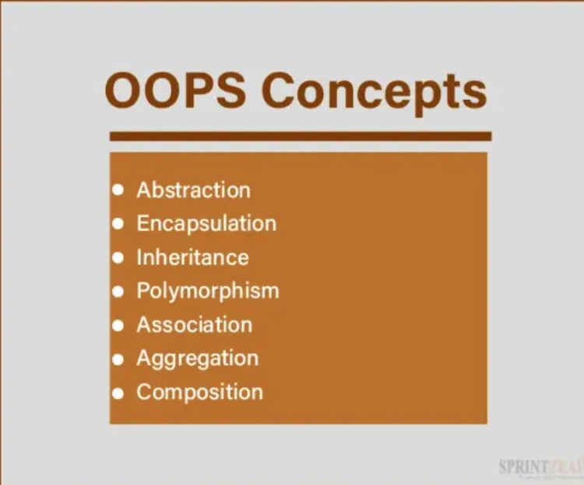

Slide 14
What are Objects?

Slide 15
Objects:
In Java, an object is more than just a runtime entity; it’s the embodiment of a class. These objects mirror real-world entities, complete with both state and behavior. Think of a ‘Car’ object based on a ‘Car’ class. It possesses attributes like color, brand, and speed, along with behaviors like ‘accelerate’ and ‘brake’. This is where Java OOP concepts come to life.

Slide 16
Objects are always called instances of a class which are created from a class in java or any other language. They have states and behaviour.
These objects always correspond to things found in the real world, i.e., real entities. So, they are also called run-time entities of the world. These are self–contained which consists of methods and properties which make data useful. Objects can be both physical and logical data. It contains addresses and takes up some space in memory. Some examples of objects are a dog, chair, tree etc.
When we treat animals as objects, it has states like colour, name, breed etc., and behaviours such as eating, wagging the tail etc.

Slide 17
Suppose, we have created a class called My book, we specify the class name followed by the object name, and we use the keyword new.
Object Example 1:
In the above example, a new object is created, and it returns the value of x which may be the number of books.
Mybook Myobj= new Mybook ();
This is the statement used for creating objects.
System.out.println(Myobj.x);
1 2 3 4 5 6 7 | Public class Mybook { int x=10; Public static void main (String args []) { Mybook Myobj= new Mybook (); System.out.println(MyObj.x); } }

Slide 18
What are Classes?

Slide 19
A class in Java serves as a blueprint for creating objects. It bundles data (attributes) and behavior (methods) that define the object. Consider a ‘Car’ class; it defines attributes like color and methods like ‘accelerate()’. Essentially, a class is a template that characterizes what can be instantiated as an object, exemplifying OOPs concepts.

Slide 20
Classes are like object constructors for creating objects. The collection of objects is said to be a class. Classes are said to be logical quantities. Classes don’t consume any space in the memory. Class is also called a template of an object. Classes have members which can be fields, methods and constructors. A class has both static and instance initializers.
A class declaration consists of:
Modifiers: These can be public or default access.
Class name: Initial letter.
Superclass: A class can only extend (subclass) one parent.
Interfaces: A class can implement more than one interface.
Body: Body surrounded by braces, { }.

Slide 21
A class keyword is used to create a class. A simplified general form of the class definition is given below:
1 2 3 4 5 6 7 8 9 10 11 12 13 14 15 16 17 | class classname { type instance variable 1; type instance variable 2; . . . type instance variable n; type methodname 1 (parameter list) { // body od method } type methodname 2 (parameter list) { // body od method } type methodnamen (parameter list) { // body od method } }

Slide 22
What is Abstraction?

Slide 23
Abstraction is a process which displays only the information needed and hides the unnecessary information. We can say that the main purpose of abstraction is data hiding. Abstraction means selecting data from a large number of data to show the information needed, which helps in reducing programming complexity and efforts.
There are also abstract classes and abstract methods. An abstract class is a type of class that declares one or more abstract methods. An abstract method is a method that has a method definition but not implementation. Once we have modelled our object using data abstraction, the same sets of data can also be used in different applications—abstract classes, generic types of behaviours and object-oriented programming hierarchy. Abstract methods are used when two or more subclasses do the same task in different ways and through different implementations. An abstract class can have both methods, i.e., abstract methods and regular methods.

Slide 24
We collect the following information.
Name
Class
Address
Dob
Fathers name
Mothers’ names and so on.
We may not require every information that we have collected to fill out the application. So, we select the data that is required to fill out the application. Hence, we have fetched, removed, and selected the data, the student information from large data. This process is known as abstraction in the oops concept.

Slide 25
Abstract class example:
1 2 3 4 5 6 7 8 9 10 11 12 13 14 | //abstract parent class Abstract class animal { //abstract method public abstract void sound ( ) ; } Public class lion extends animal { Public void sound ( ) { System.out.println (“ roar “ ); } public Static void main ( String args [ ] ) { animal obj = new lion ( ); obj. sound (); } }
Output: Roar

Slide 26
What is Inheritance?

Slide 27
Inheritance is a method in which one object acquires/inherits another object’s properties, and inheritance also supports hierarchical classification. The idea behind this is that we can create new classes built on existing classes, i.e., when you inherit from an existing class, we can reuse methods and fields of the parent class. Inheritance represents the parent-child relationship. To know more about this concept check the free inheritance in java course.
For example, a whale is a part of the classification of marine animals, which is part of class mammal, which is under that class of animal. We use hierarchical classification, i.e., top-down classification. If we want to describe a more specific class of animals such as mammals, they would have more specific attributes such as teeth; cold-blooded, warm-blooded, etc. This comes under the subclass of animals whereas animals come under the superclass. The subclass is a class which inherits properties of the superclass. This is also called a derived class. A superclass is a base class or parental class from which a subclass inherits properties.

Slide 28
There are five types of inheritance single, multilevel, multiple, hybrid and hierarchical.
Single level
In this one class i.e., the derived class inherits properties from its parental class. This enables code reusability and also adds new features to the code. Example: class b inherits properties from class a.
Class A is the base or parental class and class b is the derived class.

Slide 29
Single level
In this one class i.e., the derived class inherits properties from its parental class. This enables code reusability and also adds new features to the code. Example: class b inherits properties from class a.
1 2 3 4 5 6 | Class a { … } Class b extends class a { … }

Slide 30
Multilevel
This one class is derived from another class which is also derived from another class i.e., this class has more than one parental class, hence it is called multilevel inheritance.
Syntax:
1 2 3 4 5 6 7 8 9 | Class a { …. } Class b extends class a { …. } Class c extends class b { … }

Slide 31
Hierarchical level
In this one parental class has two or more derived classes or we can say that two or more child classes have one parental class.
1 2 3 4 5 6 7 8 9 | Class a { … } Class b extends class a { .. } Class c extends class a { .. }
Syntax:

Slide 32
Hybrid inheritance
This is the combination of multiple and multilevel inheritances and in java, multiple inheritances are not supported as it leads to ambiguity and this type of inheritance can only be achieved through interfaces.
Consider that class a is the parental or base class of class b and class c and in turn, class b and class c are parental or a base class of class d. Class b and class c are derived classes from class a and class d is derived class from class b and class c.

Slide 33
1 2 3 4 5 6 7 8 9 10 11 12 13 14 15 16 17 18 19 20 21 | // a simple example of inheritance //create a superclass Class Add { int my; int by; void setmyby (int xy, int hy) { my=xy; by=hy; } } /create a sub class class b extends add { int total; void sum () { public Static void main (String args [ ] ) { b subOb= new b ( ); subOb. Setmyby (10, 12); subOb. Sum ( ) ; System.out.println(“total =” + subOb. Total); } }
It gives output as – total = 22

Slide 34
What is Polymorphism?

Slide 35
What is Polymorphism?
Polymorphism refers to many forms, or it is a process that performs a single action in different ways. It occurs when we have many classes related to each other by inheritance. Polymorphism is of two different types, i.e., compile-time polymorphism and runtime polymorphism. One of the examples of Compile time polymorphism is that when we overload a static method in java. Run time polymorphism also called a dynamic method dispatch is a method in which a call to an overridden method is resolved at run time rather than compile time. In this method, the overridden method is always called through the reference variable. By using method overloading and method overriding, we can perform polymorphism. Generally, the concept of polymorphism is often expressed as one interface, and multiple methods. This reduces complexity by allowing the same interface to be used as a general class of action.

Slide 36
Example:
1 2 3 4 5 6 7 8 9 10 11 12 13 14 15 16 17 18 19 20 | public class Bird { … Public void sound ( ) { System.out.println ( “ birds sounds “ ); } } public class pigeon extends Bird { … @override public void sound ( ) { System.out.println( “ cooing ” ) ; } } public class sparrow extends Bird ( ) { …. @override Public void sound ( ){ System.out.println( “ chip ” ) ; } }

Slide 37
Polymorphism in java can be classified into two types:
Static / Compile-Time Polymorphism
Dynamic / Runtime Polymorphism

Slide 38
What is Compile-Time Polymorphism in Java?
Compile-Time polymorphism in java is also known as Static Polymorphism. to resolved at compile-time which is achieved through the Method Overloading.
What is Runtime Polymorphism in Java?
Runtime polymorphism in java is also known as Dynamic Binding which is used to call an overridden method that is resolved dynamically at runtime rather than at compile time.

Slide 39
What is Encapsulation?

Slide 40
Encapsulation is one of the concepts in OOPs concepts; it is the process that binds together the data and code into a single unit and keeps both from being safe from outside interference and misuse. In this process, the data is hidden from other classes and can be accessed only through the current class’s methods. Hence, it is also known as data hiding. Encapsulation acts as a protective wrapper that prevents the code and data from being accessed by outsiders. These are controlled through a well-defined interface.
Encapsulation is achieved by declaring the variables as private and providing public setter and getter methods to modify and view the variable values. In encapsulation, the fields of a class are made read-only or write-only. This method also improves reusability. Encapsulated code is also easy to test for unit testing.

Slide 41
1 2 3 4 5 6 7 8 9 10 11 12 13 14 15 16 17 18 19 20 21 22 | class animal { // private field private int age; //getter method Public int getage ( ) { return age; } //setter method public void setAge ( int age ) { this. Age = age; } } class Main { public static void main (String args []); //create an object of person Animal a1= new Animal (); //change age using setter A1. setAge (12); // access age using getter System.out.println(“ animal age is ” + a1. getage ( ) ); } }
Output: Animal age is 12

Slide 42
Coupling in Java

Slide 43
Coupling refers to the relationship between two classes. It indicates the knowledge one object or class has of another. That means that if one class changes its properties or behaviour, it will affect the dependent changes in the other class. Therefore, these changes will depend upon the level of interdependence the two classes have between them. There are two types of coupling, namely tight coupling, and loose coupling.

Slide 44
Tight coupling: If one class is strongly interrelated to another class, it is said to have a tight coupling with that class.
1 2 3 4 5 6 7 8 9 10 11 | public class College{ public void status() { System.out.println("College is open today"); } } public class Student{ College obj = new College(); public void goToCollege() { obj.status(); } }

Slide 45
Loose coupling: If one class is weakly interrelated to another class, it is said to have loose coupling with that class.
Loose coupling is preferred over tight coupling. A class can achieve this with the help of interfaces, as shown below.
1 2 3 4 5 6 7 8 9 10 11 12 13 14 15 16 17 18 19 | public interface College{ void status(); } class CollegeStatus1 implements College{ public void status() { System.out.println("College is open monday to friday"); } } class CollegeStatus2 implements College{ public void status() { System.out.println("College is open on saturday"); } } public class Student{ College obj = new CollegeStatus1(); public void goToCollege() { obj.status(); } }

Slide 46
Cohesion in Java

Slide 47
Java Cohesion measures how the methods and the attributes of a class are meaningfully and strongly related to each other and how focused they are on performing a single well-defined task for the system. This is used to indicate the degree to which a class has a single, well-focused responsibility. More cohesive classes are good to keep them for code reusability. Low cohesive classes are difficult to maintain as they have a less logical relationship between their methods and properties. It is always better to have highly cohesive classes to keep them well focused for a single work.

Slide 48
Low Cohesion: In the following code, we have a class called Book. But it is less cohesive because
it comprises less focussed and independent attributes and methods to the class. This class should contain information related to the Book. Therefore, the person’s name and age method are making this classless cohesive.
1 2 3 4 5 6 7 8 9 10 11 12 13 14 15 16 17 18 | class Book{ int price = 299; //related attribute String name = "Sam"; //unrelated attribute //related methods to Book class public String author(String name) { return name; } public String title(String subject) { return subject; } public int id(int number) { return number; } //unrelated methods to Book class public int age(int age) { return age; } }

Slide 49
High Cohesion: When the class has a single well-defined purpose or task, it is
said to be highly cohesive. So, in the above example code,
if we remove the information related to the person, then the class becomes highly cohesive, as shown below.
1 2 3 4 5 6 7 8 9 10 11 12 13 | class Book{ int price = 299; //related attribute //related methods to Book class public String author(String name) { return name; } public String title(String subject) { return subject; } public int id(int number) { return number; } }

Slide 50
Association in Java

Slide 51
Association is a relation between two separate classes that establishes with the help of their Objects. It specifies the relationship between two or more Objects. Association can be one-to-one, one-to-many, many-to-one, and many-to-many. Let us understand this with real-world examples, suppose the relationship between the bus and the passengers. A bus can have only one driver(one-to-one). Many passengers can associate with the single bus(many-to-one). A single passenger can associate with many different buses(one-to-many). Also, many passengers can associate with the many different buses(many-to-many). One object is associated with another object to use the functionality and services provided by another object.

Slide 52
1 2 3 4 5 6 7 8 9 10 11 12 13 14 15 16 17 18 19 20 21 22 23 24 25 26 27 28 29 30 31 32 33 34 35 36 37 38 39 40 41 42 43 44 45 46 47 48 49 | /class bus class Bus { private String name; // bus name Bus(String name) { this.name = name; } public String getBusName() { return this.name; } } //passenger class class Passenger { // passenger name private String name; // passenger seat id number private int seatId; Passenger(String name, int seatId) { this.name = name; this.seatId = seatId; } public String getPassengerName() { return this.name; } public int getPassengerId() { return this.seatId; } } //Association between both the //classes in the main method class Demo { public static void main (String[] args) { Bus bus = new Bus("Shree Travels"); Passenger psg = new Passenger("Sneha", 52); System.out.println(psg.getPassengerName() + " with seat number " + psg.getPassengerId() + " is a passenger of " + bus.getBusName()); } }
Consider the following code below:
Output:
Sneha with seat number 52 is a passenger of Shree Travels

Slide 53
Aggregation

Slide 54
Java Aggregation is a weak association and represents a relationship between an object containing other objects. This represents a part of a whole relationship where a part can exist without a whole. Let’s take an example of the relationship between Group and Person. A Person may belong to multiple Groups. Hence a Group can have multiple Persons. But if we delete a Group, the Person object will not destroy. Aggregation represents the Has-A relationship, unidirectional association, i.e., a one-way relationship. For instance, the group can have persons, but vice versa is not possible and thus unidirectional. In this section, both entries can survive individually, which means ending one entity will not affect the other entity. Hence, both objects are independent in aggregation.

Slide 55
1 2 3 4 5 6 7 8 9 10 11 12 13 14 15 16 17 18 19 20 21 22 23 24 25 26 27 28 29 30 31 32 33 34 35 36 37 38 39 40 41 42 43 44 45 46 47 48 49 50 51 52 53 54 55 56 57 58 59 60 61 62 63 64 65 66 67 68 69 70 71 72 | import java.util.*; //person class class Person { private String name; private int age ; Person(String name, int age) { this.name = name; this.age = age; } public String getName() { return name; } public int getAge() { return age; } } /* Group class contains the list of person Objects. It is associated with the person class through its Object(s). */ //group class class Group { private String groupName; private List<Person> persons; Group(String groupName, List<Person> persons) { this.groupName = groupName; this.persons = persons; } } //main method class Demo { public static void main (String[] args) { //creating objects of person class Person a = new Person("Tanmay", 17); Person b = new Person("Sam", 18); Person c = new Person("Pitu", 19); Person d = new Person("Khushi", 20); //making a list of persons belongs to social welfare group List<Person> p1 = new ArrayList<>(); p1.add(a); p1.add(c); //making a list of persons belongs to drama fest group List<Person> p2 = new ArrayList<>(); p2.add(b); p2.add(d); //creating objects of group class Group swGrp = new Group("Social Welfare", p1); Group dfGrp = new Group("Drama Fest", p2); //before deleting drama fest group System.out.println("List of persons in Drama Fest group:"); for(Person p : p2) { System.out.println("Person name: " + p.getName() + ", Age:" + p.getAge() + ", Group: Drama Fest"); } //deleting drama fest group dfGrp = null; //after deleting drama fest group //person list will not destroy System.out.println("List of persons after deleting Drama Fest group:"); for(Person p : p2) { System.out.println("Person name: " + p.getName() + ", Age: " + p.getAge()); } } }

Slide 56
Considering the following code example:
Output:
List of persons in Drama Fest group:
Person name: Sam, Age:18, Group: Drama Fest
Person name: Khushi, Age:20, Group: Drama Fest
List of persons after deleting Drama Fest group:
Person name: Sam, Age: 18
Person name: Khushi, Age: 20

Slide 57
Composition in Java

Slide 58
Java Composition is an association that represents a part of a whole relationship where a part cannot exist without a whole. Let’s take an example of the relationship between School and Room. The school object consists of several rooms. Whenever the school object destroys automatically, all the room objects will be destroyed, i.e., without the existing school object, there is no chance of an existing dependent object. So these are strongly associated, and this relationship is called composition. If a whole is deleted, then all parts are deleted. So composition represents the part-of relationship.
Whenever there is a composition between two entities, the created object cannot exist without the other object. Thus, in composition, both entities are dependent on each other.

Slide 59
1 2 3 4 5 6 7 8 9 10 11 12 13 14 15 16 17 18 19 20 21 22 23 24 25 26 27 28 29 30 31 32 33 34 35 36 37 38 39 40 41 42 43 44 45 46 47 48 49 50 51 52 53 54 | import java.util.*; // activity room class class ActivityRoom { public String subject; public int id; ActivityRoom(String subject, int id) { this.subject = subject; this.id = id; } } // department class class Department { private String name; //list of activity rooms in a department. private List<ActivityRoom> ar; Department(List<ActivityRoom> ar) { this.ar = ar; } // Getting total number of colleges public List<ActivityRoom> getActivityRoomsInDepartment() { return ar; } } class Demo { public static void main(String[] args) { // Creating the Objects of activity room class. ActivityRoom a1 = new ActivityRoom("Technical", 601); ActivityRoom a2 = new ActivityRoom("Business", 602); ActivityRoom a3 = new ActivityRoom("Economics", 603); // making the list of activity rooms. List<ActivityRoom> act = new ArrayList<ActivityRoom>(); act.add(a1); act.add(a2); act.add(a3); // Creating the Object of department class. Department d = new Department(act); // making the list of activity rooms in department. List<ActivityRoom> arlist = d.getActivityRoomsInDepartment(); for (ActivityRoom a : arlist) { System.out.println(a.subject + " activity room with id " + a.id); } } }
Consider the following code example:
Output:
Technical activity room with id 601
Business activity room with id 602
Economics activity room with id 603

Slide 60
Methods in Java

Slide 61
Java method is a block of code or collection of statements grouped together to complete a certain job or operation. This is used to achieve the reusability of code and can be utilized many times. It also gives easy modification and readability of code. A method is executed only when we call or invoke it. We have two categories of methods in java, i.e., pre-defined and user-defined. Predefined methods are the methods that are already defined in the Java class libraries. When a particular method is written by the user or programmer, it is known as a user-defined method. User-defined methods can be modified according to the requirement.
Let’s discuss:
Static method in Java
The abstract method in Java
Finalize method in Java
Equals method in Java

Slide 62
Static Method in Java
A method that has the static keyword in the declaration is known as the static method. In other words, a method that belongs to a class rather than an instance of a class is known as a static method. We can also create a static method by using the keyword static before the method name. The main benefit of a static method is that we can invoke the static method without even creating an object. It can access static data members and also change their values and is also used to create an instance method. The main() method is a common example of the static method.

Slide 63
Example:
1 2 3 4 5 6 7 8 9 10 11 | public class Demo { public static void main(String[] args) { displaymethod(); } static void displaymethod() { System.out.println("It is an example of static method."); } }
Output:
It is an example of a static method.

Slide 64
Abstract Method in Java
A method that is declared with keyword abstract is called an abstract method. The abstract method does not have an implementation or body, or block of code. The abstract method must always be declared in an abstract class, or we can say that if a class has an abstract method, it should be declared abstract. If a class has an abstract method, it should be declared abstract, but vice versa is not true, which means that an abstract class doesn’t need to have an abstract method compulsory. Also, If a normal class extends an abstract class, then the class must have to implement all the abstract parent class’s abstract methods, or it has to be declared abstract.

Slide 65
Example:
1 2 3 4 5 6 7 8 9 10 11 12 13 14 15 16 17 18 19 20 21 22 23 24 25 26 27 28 29 30 31 | //abstract class area abstract class Area{ /* These two are abstract methods, the child class * must implement these methods */ public abstract int areaSquare(int s); public abstract int areaRectangle(int l, int b); //Normal method public void display(){ System.out.println("Normal method in abstract class Area"); } } //Normal class extends the abstract class class Demo extends Area{ /* If we don't provide the implementation of these two methods, the * program will throw compilation error. */ public int areaSquare(int s){ return s*s; } public int areaRectangle(int l, int b){ return l*b; } public static void main(String args[]){ Area a = new Demo(); System.out.println("Area of square " + a.areaSquare(9)); System.out.println("Area of rectangle " + a.areaRectangle(3,4)); a.display(); } }
Output:
Area of square 81
Area of rectangle 12
The normal method in abstract class Area

Slide 66
Final Method in Java
A method that is declared final is called a final method. We cannot override a final method. This means the child class can still call the final method of the parent class without any problem, but it cannot override it. This is because the main purpose of making a method final is to stop the modification of the method by the sub-class.

Slide 67
Example:
1 2 3 4 5 6 7 8 9 10 11 12 13 14 15 16 17 | class DemoParent{ final void method(){ System.out.println("Parent class final method"); } } class Demo extends DemoParent{ //error void method(){ System.out.println("final method modified inside child class"); } public static void main(String args[]){ Demo d = new Demo(); d.method(); } }

Slide 68
The above code will throw an error as we are trying to modify the final method inside the child class(demo) of the parent class(demoParent).
Instead of modifying the method, we can use it as shown below:
1 2 3 4 5 6 7 8 9 10 11 12 | class DemoParent{ final void method(){ System.out.println("Parent class final method"); } } class Demo extends DemoParent{ public static void main(String args[]){ Demo d = new Demo(); d.method(); } }

Slide 69
Equals Method in Java
As the name suggests in java, .equals() is a method used to compare two objects for equality. The .equals() method in java is used to check if the two strings have similar values. It checks them character by character. One should not confuse .equals() method with == operator. The String equals() method compares the two given strings based on the content of the string, whereas the == operator is used for address comparison. If all the contents of both the strings are the same, then .equals() returns true otherwise, it returns false. If all characters are not matched, then it returns false.

Slide 70
1 2 3 4 5 6 7 8 9 10 11 12 | public class Demo { public static void main(String[] args) { String s1 = "GreatLearning"; String s2 = "GreatLearning"; String s3 = new String("GreatLearning"); System.out.println(s1 == s2); // true System.out.println(s1 == s3); // false System.out.println(s1.equals(s2)); // true System.out.println(s1.equals(s3)); // true } }

Slide 71
Message Passing in Java
Message Passing in terms of computers is a communication phenomenon between the processes. It is a kind of communication used in object-oriented programming. Message passing in Java is the same as sending an object, i.e., a message from one thread to another thread. It is utilized when threads do not have shared memory and are not able to share monitors or any other shared variables to communicate. In message passing calling program sends a message to a process and relies on that process to run its own functionality or code. Message passing is easy to implement, has faster performance, and we can build massive parallel models by using it.
There are two types of it: Synchronous and Asynchronous.
Synchronous message passing occurs when the objects run at the same time.
In the case of an Asynchronous message passing, the receiving object can be down or busy when the requesting object sends the message.

Slide 72
Advantages of OOPs Concept

Slide 73
Some of the advantages are:
Re-usability
When we say re-usability, it means that “write once, use it multiple times” i.e., reusing some facilities rather than building it again and again, which can be achieved by using class. We can use it n number of times whenever required.
Data redundancy
It is one of the greatest advantages in oops. This is the condition which is created at the data storage when the same piece of data is held at two different places. If we want to use similar functionality in multiple classes, we can just write common class definitions for similar functionalities by inheriting them.
Code maintenance
It is easy to modify or maintain existing code as new objects which can be created with small differences from the existing ones. This helps users from doing rework many times and modifying the existing codes by incorporating new changes to it.
Security
Data hiding and abstraction are used to filter out limited exposure which means we are providing only necessary data to view as we maintain security.
Design benefits
The designers will have a long and more extensive design phase, which results in better designs. At a point of time when the program has reached critical limits, it will be easier to program all non-oops separately.
Easy troubleshooting
Using encapsulation objects is self-constrained. So, if developers face any problem easily it can be solved. And there will be no possibility of code duplicity.
Flexibility
Problem-solving

Slide 74
Disadvantages of OOPs Concept
Effort – A lot of work is put into creating these programs.
Speed – These programs are slower compared to other programs.
Size – OOPs programs are bigger when compared to other programs.

Slide 75
Disadvantages of OOPs Concept

Slide 76
Differences between Object-Oriented Programming, Procedural Oriented Programming?

Slide 77
ALGORITHM
Write a program to input marks of five subjects Physics, Chemistry, Biology, Mathematics and Computer. Calculate percentage and grade according to following:
Percentage >= 90% : Grade A
Percentage >= 80% : Grade B
Percentage >= 70% : Grade C
Percentage >= 60% : Grade D
Percentage >= 40% : Grade E
Percentage < 40% : Grade F

Slide 78
Write a program to input basic salary of an employee and calculate its Gross salary according to following:
Basic Salary <= 10000 : HRA = 20%, DA = 80%
Basic Salary <= 20000 : HRA = 25%, DA = 90%
Basic Salary > 20000 : HRA = 30%, DA = 95%

Slide 79
while purchasing certain items, a discount of 10% is offered if the quantity purchased is more than 100. If quantity and price per item are input through the keyboard, write a program to calculate the total expenses

Slide 80
A company insures its drivers in the following cases:
If the driver is married
If the driver is unmarried, male & above 30 years of age
If the driver is unmarried, female & above 25 years of age

Slide 81
A library charges a fine for every book returned late. For first 5 days the fine is 50 Naira, for 6-10 days fine is 100 Naira and above 10 days fine is 500 Naira. If you return th1e book after 30 days your membership will be cancelled. Write a program to accept the number of days the member is late to return the book and display the fine or the appropriate message 1

Slide 82
Switch Statement in Java
The switch statement is Java's multi-way branch statement. It is used to take the place of long if-else chains, and make them more readable. However, unlike if statements, one may not use inequalities; each value must be concretely defined.
There are three critical components to the switch statement:
Case: This is the value that is evaluated for equivalence with the argument to the switch statement.
Default:This is an optional, catch-all expression, should none of the case statements evaluate to true.
Abrupt completion of the case statement; usually break: This is required to prevent the undesired evaluation of further case statements

Slide 83
Syntax: switch ( expression ) { case 1 : // Block of Statement break; case 2 : // Block of Statement break; case 3 : // Block of Statement break; case 4 : // Block of Statement break; . . default : // Block of Statement break; }

Slide 84
CLASS ACTIVITIES
Write a program to create simple calculator using switch Statement
Q1. Write a program to read a weekday number and print weekday name using switch statement
Q2. Write a program to Check whether a character is a vowel or consonant using switch statement
Q3. Write a program to Check whether the number is even or odd using switch statement
Q4 Write a program to check whether a person is eligible to vote or Not using switch statement

